Slide 1
Amazon API Gateway
Application Programming Interface -- vikas

Slide 2
API Gateway is a powerful AWS service that allows you to host a REST endpoint that is backed by an AWS service (in this case, Lambda). We learn how to create a REST Endpoint using API Gateway. Requests are served by a Lambda Function (as opposed to a traditional server). I start by creating a Lambda function and coding up a basic handler using Python (code below). From there, I create a API Gateway resource that acts as a publicly facing REST Endpoint. I continue to hook up the endpoint to the previously created Lambda function. Finally, I test the configuration by invoking the REST endpoint through my browser and verify my Lambda was serving the content back.
Notes:
Rest API is a application program that uses HTTP request to GET,PUT ,POST & DELETE Data .It receive and responds to request .
Web Socket API -Two way communication between client application and your backend .Backend sends call back messages to connect to client .
Lambda function code - https://gist.github.com/djg07/678f7ae...
☁Topics covered include: - Lambda Function Creation - Lambda Function API Gateway Handler - API Gateway Resource - RESTful GET Endpoint

Slide 3
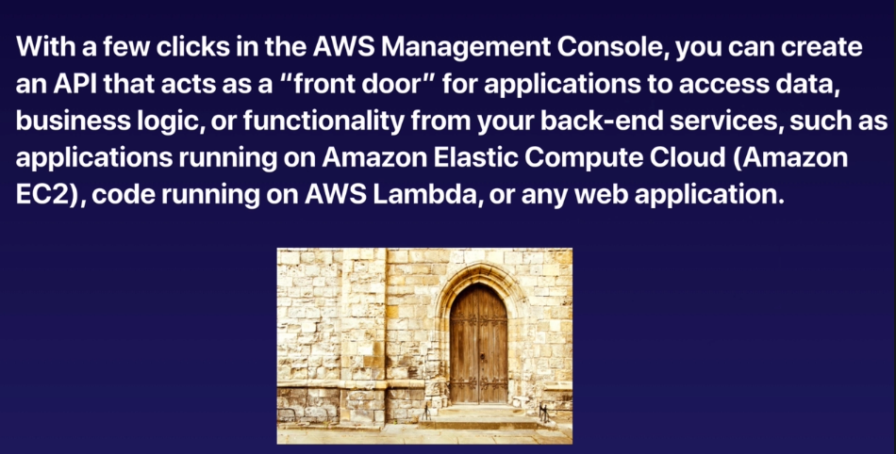
Notes:
import json
print('Loading function')
def lambda_handler(event, context):
#1. Parse out query string params
transactionId = event['queryStringParameters']['transactionId']
transactionType = event['queryStringParameters']['type']
transactionAmount = event['queryStringParameters']['amount']
print('transactionId=' + transactionId)
print('transactionType=' + transactionType)
print('transactionAmount=' + transactionAmount)
#2. Construct the body of the response object
transactionResponse = {}
transactionResponse['transactionId'] = transactionId
transactionResponse['type'] = transactionType
transactionResponse['amount'] = transactionAmount
transactionResponse['message'] = 'Hello from Lambda land'
#3. Construct http response object
responseObject = {}
responseObject['statusCode'] = 200
responseObject['headers'] = {}
responseObject['headers']['Content-Type'] = 'application/json'
responseObject['body'] = json.dumps(transactionResponse)
#4. Return the response object
return responseObject
https://gist.github.com/djg07/678f7aea58b6c5b8d93c15af8577e0f2

Slide 4
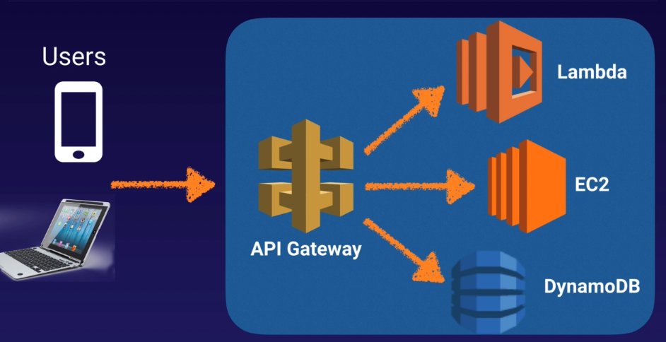

Slide 5
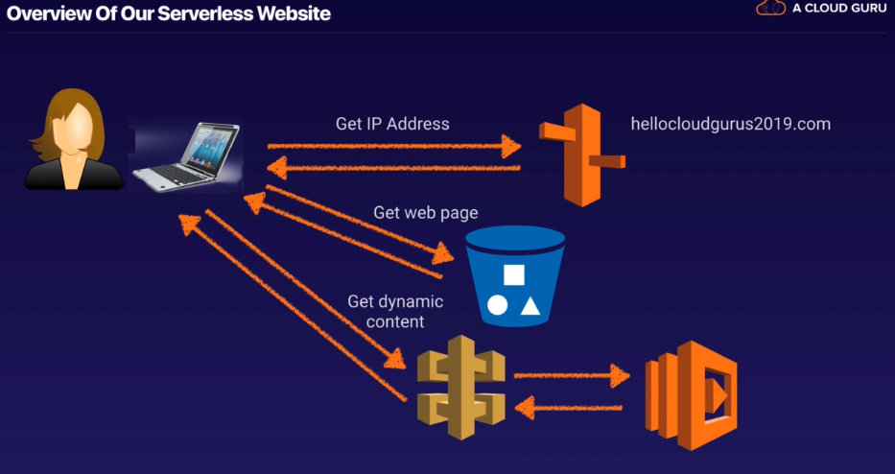
Notes:
Lambda: Python ::3.6 ::Role :: Choose simple micro service permissions
Code:
def lambda_handler(event, context):
print("In lambda handler")
resp = {
"statusCode": 200,
"headers": {
"Access-Control-Allow-Origin": "*",
},
"body": "Kumar vikas"
}
return resp
Configure Trigger :
Create New API
Security : AWS IAM == > If you click on the API you get a error message

Slide 6
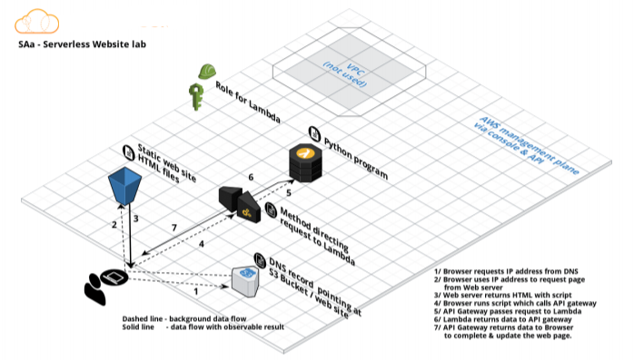
Notes:
Click on the name to go to the API Gateway == > Actions – Delete Any Method – Create a GET request –
Integration type :: Lambda
Check on Use Lambda proxy Integration
Choose the correct region and lambda name – Use default Time out
Action – Deploy API – Default stage –Name it -- Click on Default -- GET – url – you get the name
Copy the link – edit index.html
Create a bucket and upload a image
Create another buket and make it public – static bucket hosting – yes – upload error.html and index.html – make them too public
<html>
<script>
function myFunction() {
var xhttp = new XMLHttpRequest();
xhttp.onreadystatechange = function() {
if (this.readyState == 4 && this.status == 200) {
document.getElementById("my-demo").innerHTML = this.responseText;
}
};
xhttp.open("GET", "YOUR-API-GATEWAY-LINK-HERE", true);
xhttp.send();
}
</script>
<body><div align="center"><br><br><br><br>
<h1>Hello <span id="my-demo">Cloud Gurus!</span></h1>
<button onclick="myFunction()">Click me</button><br>
<img src="https://s3.amazonaws.com/acloudguru-opsworkslab-donotdelete/ACG_Austin.JPG"></div>
</body>
</html>

